Slide 1
REACT NATIVE
TESLA CLONE

Slide 2
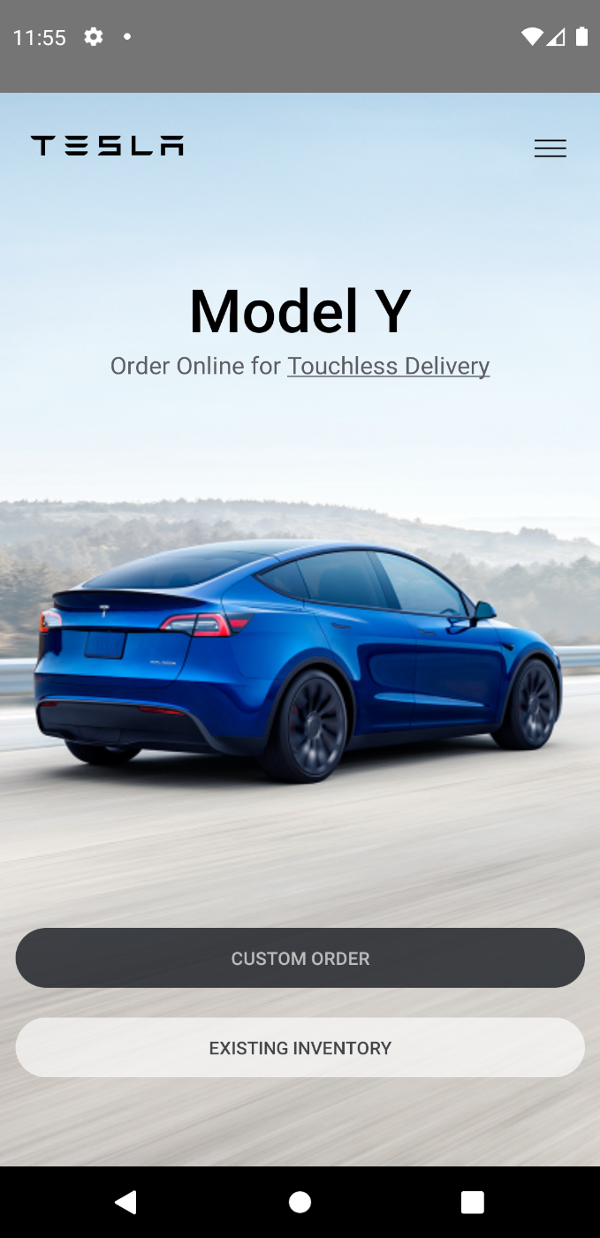


REACT NATIVE BUILD
TESLA CLONE APP BUILD ANDROID BASED

Slide 3
LETS GET STARTED
Intialise your project
npx react-native init TeslaClone
Open TeslaClone in editor of your choice
And then start your project
npx react-native run-android
to start your emulator and project

Slide 4
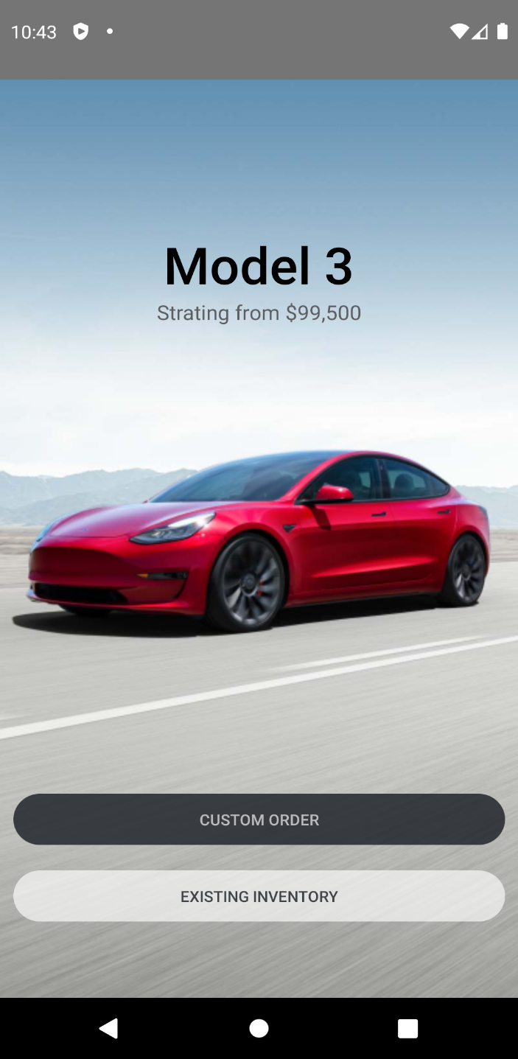
Car Item Component
Render the text (Model , etc.)
Render the background image
Create the separate component for CarItem

Slide 5
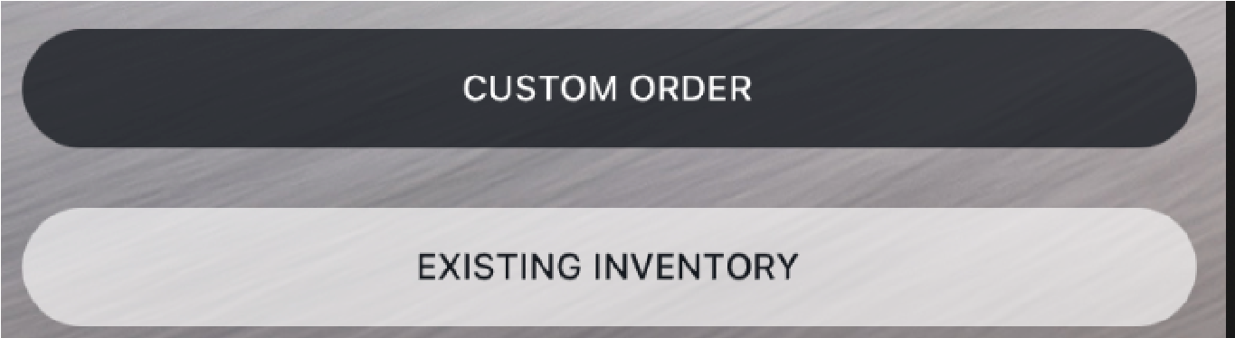
Button Component
Create a separate component
Receive props
Style the button based on ‘type’ prop

Slide 6
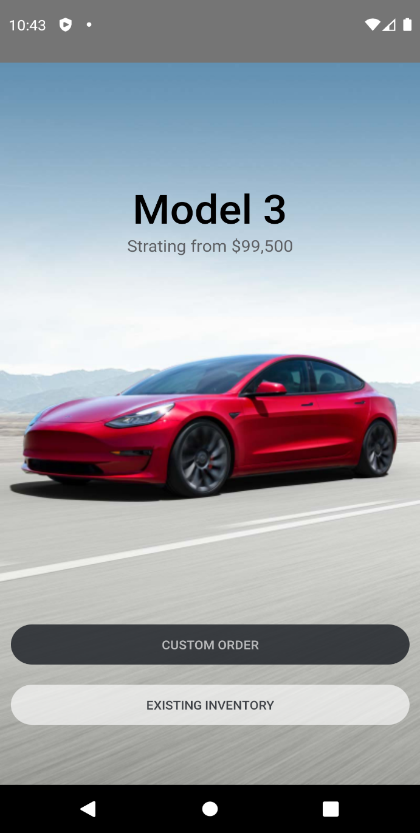
Finish CarItem component
Use buttons
Implement props

Slide 7

Render a scrollable list for Cars
Use a Dummy data
Render a Flatlist
Setup Snap to view

Slide 8
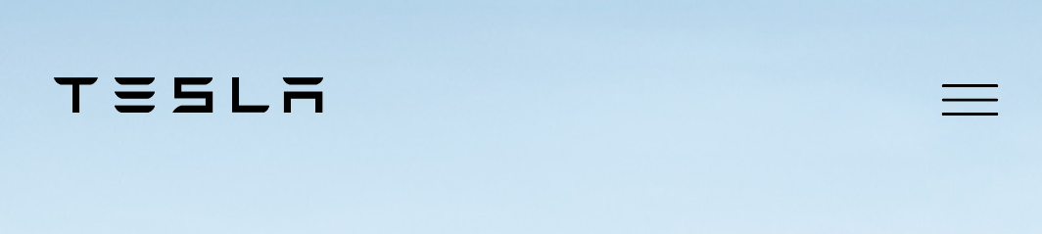
Render the Header of the app

